Slide 1
WELCOME
Back to School
Mrs. Carroll
4th Grade
Room 30
2019 - 2020

Slide 2
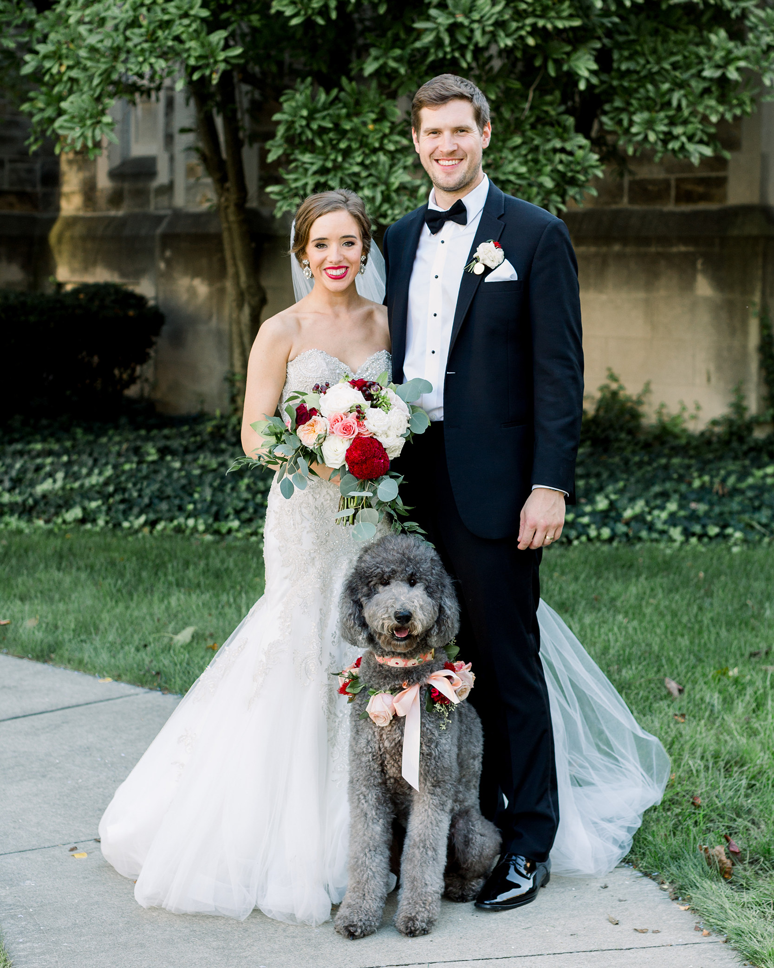
Meet Your TEACHER
Hello! I’m Mrs. Carroll!
I am so excited to be your 4th grade teacher! It is going to be a great year full of new friends, new adventures, and new discoveries. This will be my very first year teaching!
I couldn’t be happier to be starting my teaching career here
at Kerkstra
and with YOU!
Me with Mr. Carroll and our labradoodle, Elphie, on our wedding day!

Slide 3
About Mrs.Carroll
In June I graduated from National Louis University with my Masters of Arts in Teaching. Prior to this, I received my Bachelor of Arts in Marketing from Indiana State University in 2013. After working in the industry for a few years, I decided to go back to school to fulfill my dream of becoming a teacher.
I was born in Germany and have lived in five different states (my dad was in the Army), For most of my childhood I grew up in
Indiana. I have 2 sisters and 2 brothers!
I got married last October to my wonderful husband, Parker. We have a 3 year old
labradoodle named Elphie!

Slide 4
My FAVORITES!
Color: Yellow Drink: Coffee Subject: Social Studies Children's Book: Charlie and the Chocolate Factory Store: Target Sports: Football & Baseball Place: Glacier National Park in Montana Hobbies: Reading, cooking,
traveling with my husband,
spending time with friends, family,
and Elphie!

Slide 5
My promise to YOU
In our classroom YOU will always be cared about and YOUR opinions, thoughts, and ideas will always be valued.
YOU have unique talents and strengths and I can't wait for you to share them with your classmates!
I know that YOU are going to bring so much to our class and I can't wait to learn more about YOU!

Slide 6
Contact INFO
Email: scarroll@d142.org
Class website: http://d142-scarroll.weebly.com/
Twitter: @MrsCarroll142
Phone: 708-687-2860
x4330

Slide 7
Arrival and DISMISSAL
School starts at 8:50 am
Walkers/car riders may arrive no earlier than 8:35 am
*please review the important back to school document Mr. Kulik sent for more information on arrival and dismal procedures*
School ends at 3:15 pm
On ½ days, school hours
are 8:50 am – 11:50 am
Any changes to arrival or
dismissal must be hand written

Slide 8
Attendance POLICY
If your child is ill, be sure to call the attendance line at 708-803-8212 prior to 9:00 am. All homework requests should be made at the time of your call.
Absences of five consecutive days require a doctor’s note.
In the event a vacation is planned
during the school year, please
contact the main office for
further directions.

Slide 9
Our SCHEDULE
Art and Music: Mondays and Fridays from 9:30-10:00 am Library: Wednesdays from 2:05-255 pm Technology: Tuesdays from 2:15-2:55 pm Physical Education: Students will have PE daily from 9:00-9:25 am

Slide 10
Human Centered Classroom
In our human centered classroom we focus on all people being learners, including adults.
We learn and grow together
to maximize our potential.

Slide 11
21st century LEARNING SPACE
In our classroom we have flexible seating furniture and will have a class set of 8 iPad that we use regularly during class time in all subject areas.

Slide 12
Our CURRICULUM
Standards-based
Common Core State Standards,
NGSS (next generation science standards)
Social Science Learning Standards
Go Math, EL Education, Mystery Science
TECHNOLOGY!
Check class website regularly for updates and resources!

Slide 13
Homework POLICY
At the end of each day, it will be the students responsibility to write any assignments down in their notebook.
Math: Homework will be given regularly. Your student should practice math skills at least 3 times a week.
Reading/Language: Each week we will be reading a new story which will focus on reading strategies. Students may have homework to reinforce skills and strategies for the story.
Your student should be reading 15 minutes EVERY NIGHT!
Science and Social Studies: Most of our activities and experiments will take place in the classroom, so little homework will be sent home in these subjects.
Contact me with any problems or concerts!

Slide 14
Other q’s
No birthday/holiday treats (See Wellness policy)
Healthy individual snack (Morning snack time)
Water bottles - water only!
Home/School compact sheet will be sent home this week and will needed to be signed and returned by both parents and student

